Slide 1
Accounts solver

Slide 2
Team name : Task Breakers
Team number : 29
Team members:
suvetha.B (711718205043)
Taniya joseph.J (711718205044)
Thirumurugan.N (711718205045)

Slide 3
Problem statement :
A project for maintaining accounts developed by using python.

Slide 4
Academic mentor : Mr. Rajasekaran
Industrial mentor : Ms. Subashini U
ASSOCIATE
KGISL GSS

Slide 5
ABSTRACT :
The accounts solver is a python project which is used for accounting purposes business. The data were the user is prompted with choice of accounting calculations to select, based on the selection the user will give the input using GUI components and calculations were done based on the formulas and results will be displayed to the user . For example, If he chooses accounting equation the user is prompted to give two inputs which is liability( the debits of users) and the equity(the remaining of debit climbs) with respect to total assets and display to user . The computer results are taken for other operations too.

Slide 6
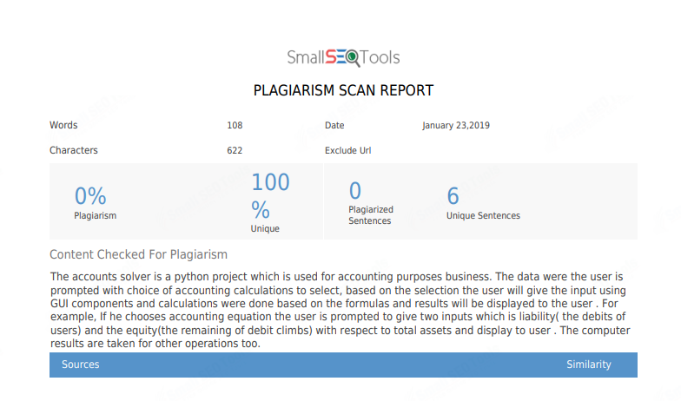

Slide 7
Accounting software
7 Accounting Formulas
1.Accounting Equation
2.Net Income
3.Break-Even Points
4.Cash Ratio
5.Profit Margin
6.Debt-to-Equity Ratio
7.Cost of Goods Sold

Slide 8
MODEL ARCHITECTURE
HOME
SELCTION SCREEN
INPUT FROM USER
OUTPUT

Slide 9
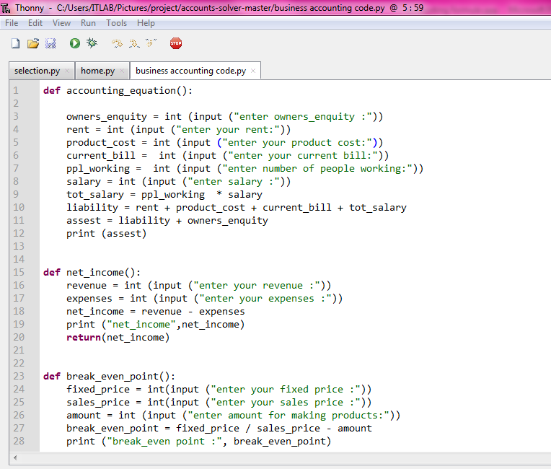
Sample code:

Slide 10
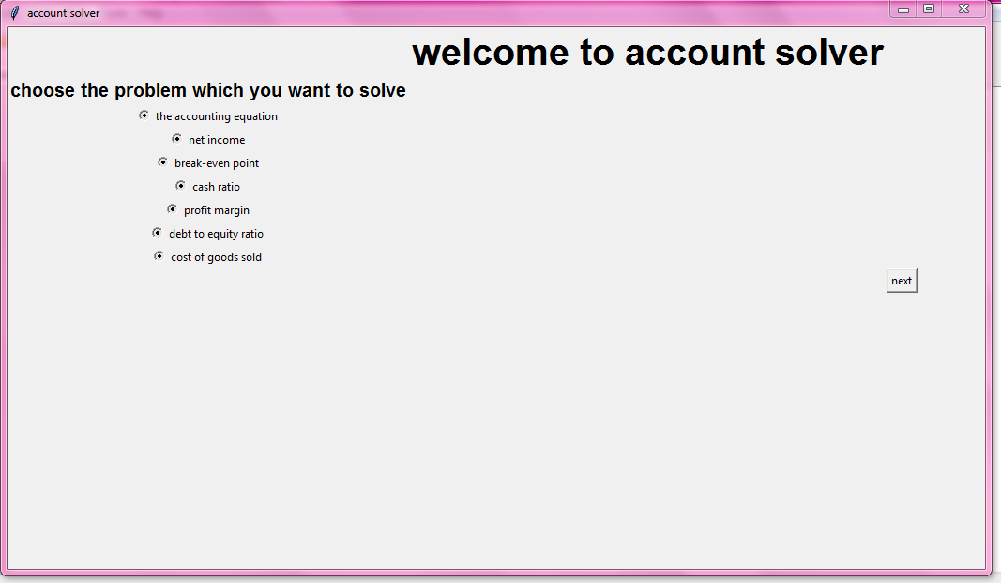
USER INTERFERENCE :

Slide 11
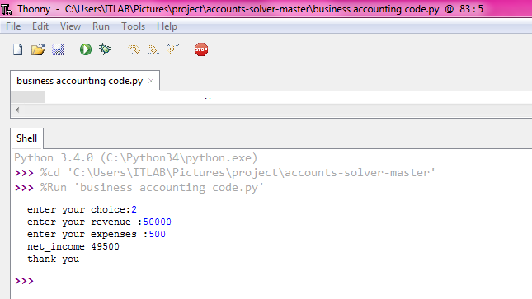
BACKEND RESULT :

Slide 12
MERITS :
Accounts solver can minimize the work of accountants.
REQUIREMENTS :
Thonny
Idle
Any IDE
PACKAGES : tkinter
LANGUAGE : Python

Slide 13
Module:
Home module
Selection module
Data Entry Module
Output Module

Slide 14
REFERENCE :
https://www.google.com/search?q=7+accounting+formulas&oq=7+&aqs=chrome.0.69i59j69i57j69i60l3j0.3695j0j7&sourceid=chrome&ie=UTF-8
https://pythonprogramming.net/python-3-tkinter-basics-tutorial/
https://likegeeks.com/python-gui-examples-tkinter-tutorial/

Slide 15
THANK
YOU

